Slide 1

Unit 2: Lesson 3 Victorians gone viral

Slide 2
Task 1: Rank the videos from 1 to 10.

Slide 3
Task 5: Read the article and find out how a cook from the 19th century went viral.

Slide 4

Task 6: Read the text and circle the correct answer.

Slide 5
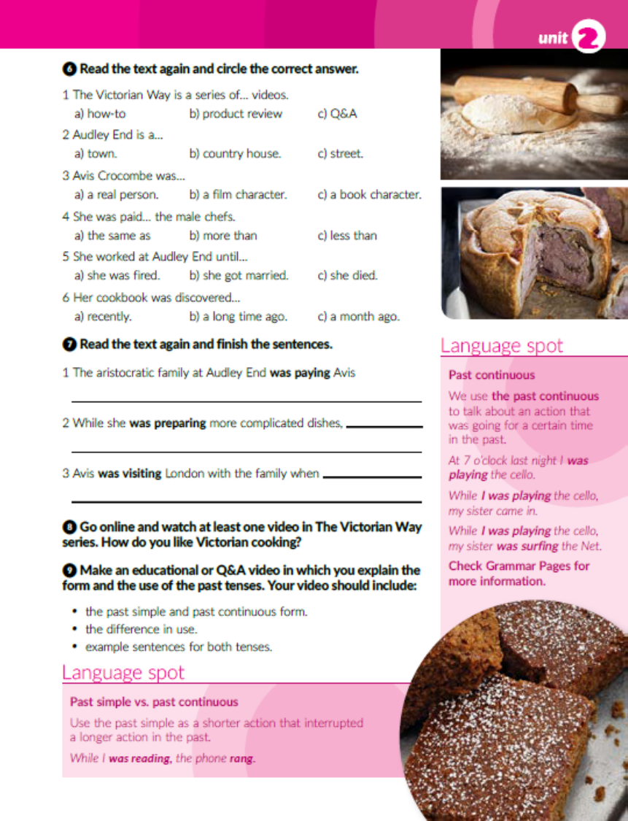
Task 7: Read the text again and finish the sentences.
half of what they were paying the French chef who came before her.
her kitchen staff was chopping, grinding and measuring the ingredients to be included in the dish.
she met her husband, Benjamin.

Slide 6
Past continuous
Past continuous koristimo za radnju koja se događala u prošlosti neko dulje vrijeme.
At 7 o’clock last night I was playing the cello.
Past continuous često upotrebljavamo u kombinaciji s glagolskim vremenom past simple kada želimo prikazati situaciju u kojoj je jedna prošla radnja prekinula drugu radnju.
While I was playing cello, my sister came in.
(past contimuous) (past simple)
Past continuous također često koristimo za dvije istovremene radnje u prošlosti.
While I was playing the cello, my sister was surfing the Net.

Slide 7

Task 8: Watch at least one video in The Victorian Way Series. How do you like Victorian cooking?
Task 9: Make an educational video about the past tenses.

Slide 8
workbook, page 33
Task 1: Circle the correct answer.

Slide 9
Task 2: Put the events in the correct order.
3
8
2
6
7
4
5

Slide 10
Task 3: Complete the sentences with the past continuous form of the verbs.
were having
were sitting
eating
were talking
wasn’t thinking

Slide 11
was visiting
were coming
wern’t cooking
was telling
was laughing
wasn’t expecting
was walking
talking
was mentioning
was steering
wasn’t freaking
was looking

Slide 12
Task 4: Which suspect seems the most suspicious to you?

Slide 13
Task 5: Circle the correct answer.

Slide 14
Task 6: Complete the sentences with the correct form of the verbs in brackets. (past simple or past continuous).
heard
was looking
saw
hit
was watching
were climbing
stopped
turned
were driving
started

Slide 15
Task 7: Choose the gramatically correct sentence.

Slide 16
Task 8: Copy the words next to the translation.
truffles
herbs
mushrooms
breadcrumbs
cooked ham
cloves
port
stock
quail’s eggs
salt
whiskey
time
sage
pigeon breasts
veal mince
pastry
parsley

Slide 17

PLAY AND LEARN!
https://wordwall.net/play/18896/944/764

